Slide 1
CC4E: Epilogue
Dr. Charles R. Severance
www.cc4e.com
code.cc4e.com (sample code)
online.dr-chuck.com

Slide 2
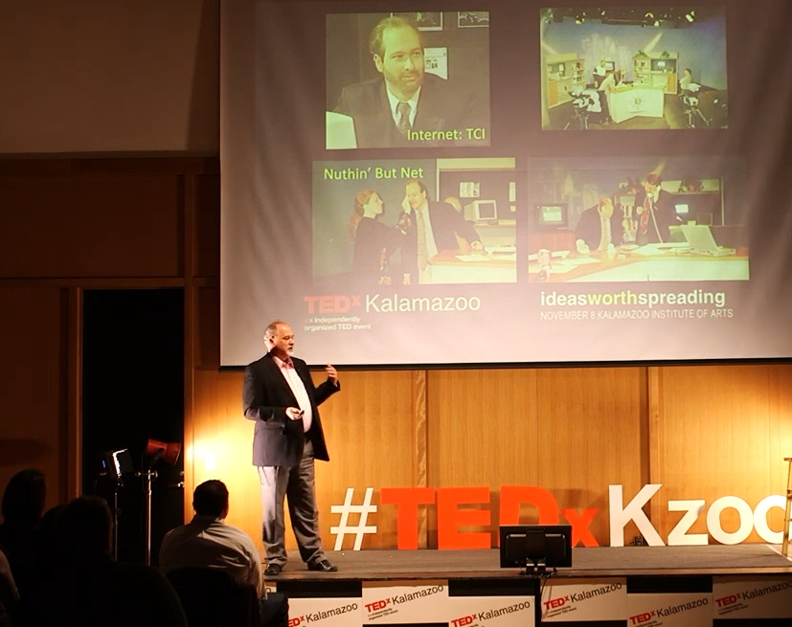
"When you think you're are finished with a journey, is often when you know where the journey actually begins.
- Dr Chuck.

Slide 3
Using K&R patterns to build Python Classes
Python String Class
Extendable character array (not in K&R)
Python List Class
Linked List from K&R 6.5.1 (Added by Dr. Chuck before 6.5)
Python 1.0 Dictionary Class (1994)
Hash Map of key / value pairs with buckets and chains from K&R 6.6

Slide 4
Building a Python str() Class

Slide 5
pystr_append()
length: 2
alloc: 10
data:
H e ∅ ? ? ? ? ? ? ?
int main() {
struct pystr * x = pystr_new();
pystr_append(x, 'H');
pystr_append(x, 'e');
pystr_append(x, 'l');
pystr_append(x, 'l');
pystr_append(x, 'o');
pystr_append(x, ' ');
pystr_append(x, 'w');
pystr_append(x, 'o');
pystr_append(x, 'r');
pystr_append(x, 'l');
pystr_append(x, 'd');
}
length: 9
alloc: 10
data:
H e l l o w o r ∅
realloc()
length: 11
alloc: 20
data:
d ∅ ? ? ? ? ? ? ? ?
H e l l o w o r l

Slide 6
Building a Python list() Class

Slide 7
struct lnode {
char *text;
struct lnode *next;
};
struct pylist {
struct lnode *head;
struct lnode *tail;
int count;
};
/* Constructor - lst = list() */
struct pylist * pylist_new() {
struct pylist *p = malloc(sizeof(*p));
p->head = NULL;
p->tail = NULL;
p->count = 0;
return p;
}
text:
C
next: 0
head: 0
tail: 0
count: 0

Slide 8
/* lst.append("Fun") */
void pylist_append(struct pylist* self, char *str) {
struct lnode *new = malloc(sizeof(*new));
new->next = NULL;
if ( self->head == NULL ) self->head = new;
if ( self->tail != NULL ) self->tail->next = new;
self->tail = new;
char *text = malloc(strlen(str)+1);
strcpy(text, str);
new->text = text;
self->count++;
}
text:
C
next:
text:
is
next: ∅
head:
tail:
count: 2

Slide 9
/* lst.append("Fun") */
void pylist_append(struct pylist* self, char *str) {
struct lnode *new = malloc(sizeof(*new));
new->next = NULL;
if ( self->head == NULL ) self->head = new;
if ( self->tail != NULL ) self->tail->next = new;
self->tail = new;
char *text = malloc(strlen(str)+1);
strcpy(text, str);
new->text = text;
self->count++;
}
text:
C
next:
text:
is
next:
head:
tail:
text:
Fun
count: 3
next: ∅

Slide 10
Building a Python dict() Class

Slide 11
Dictionary
Bucket based hash map is the answer to a common programming interview question!

Slide 12
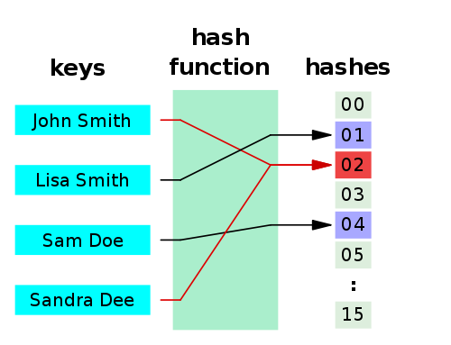
Hashes
A hash function is any algorithm or subroutine that maps large data sets to smaller data sets, called keys. For example, a single integer can serve as an index to an array (cf. associative array). The values returned by a hash function are called hash values, hash codes, hash sums, checksums, or simply hashes.
Hash functions are mostly used to accelerate table lookup or data comparison tasks such as finding items in a database...
http://en.wikipedia.org/wiki/Hash_function

Slide 13
struct dnode {
char *key;
int value;
struct dnode *prev;
struct dnode *next;
};
struct dict {
int buckets;
struct dnode *heads[4];
struct dnode *tails[4];
int count;
};
struct dict * dict_new() {
struct dict *p = malloc(sizeof(*p));
p->buckets = 4;
for(int i=0; i < p->buckets; i++ ) {
p->heads[i] = NULL;
p->tails[i] = NULL;
}
p->count = 0;
return p;
}
buckets: 4
∅
heads[0]
Hash % 4
∅
heads[1]
key
heads[2]
∅
heads[3]
∅
count: 4

Slide 14
int main(void)
{
struct dict * d = dict_new();
struct dnode *cur;
dict_put(d, "z", 8);
dict_put(d, "z", 1);
dict_put(d, "y", 2);
dict_put(d, "b", 3);
dict_put(d, "a", 4);
dict_dump(d);
dict_del(d);
}
buckets: 4
∅
heads[0]
Hash % 4
y=2
a=4
∅
heads[1]
key
heads[2]
z=1
b=3
∅
heads[3]
∅
count: 4

Slide 15
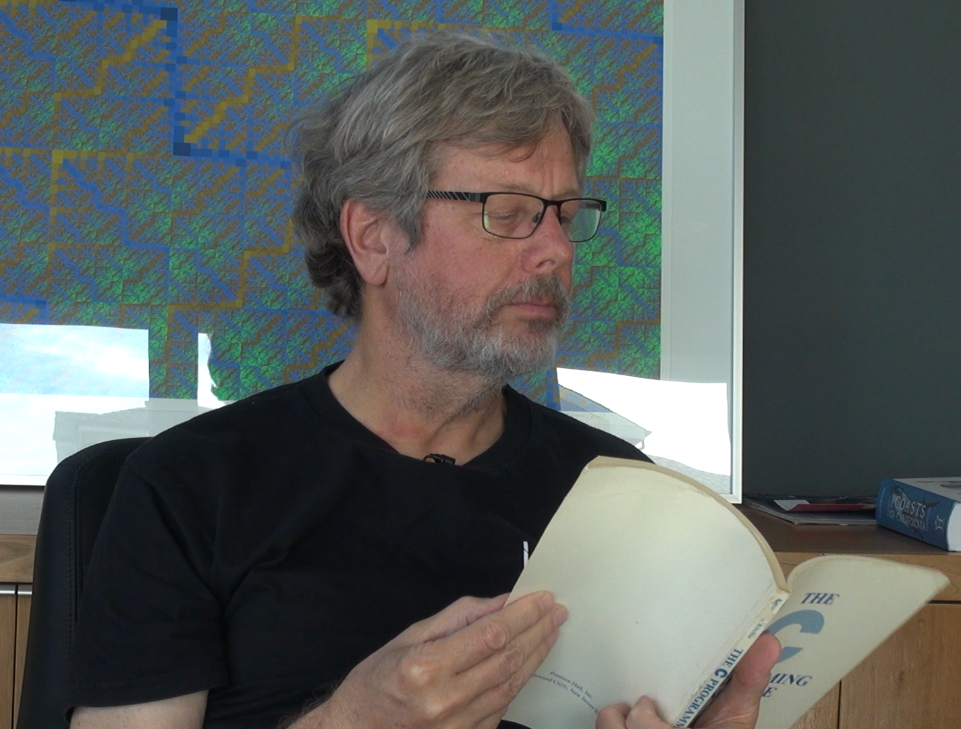
Let's go visit Guido van Rossum and ask about the relationship between Python 0.0.1 and Chapter 6 of Kernighan and Ritchie…

Slide 16
Acknowledgements / Contributions
These slides are Copyright 2023- Charles R. Severance (online.dr-chuck.com) as part of www.cc4e.com and made available under a Creative Commons Attribution 4.0 License. Please maintain this last slide in all copies of the document to comply with the attribution requirements of the license. If you make a change, feel free to add your name and organization to the list of contributors on this page as you republish the materials.
Initial Development: Charles Severance, University of Michigan School of Information
Insert new Contributors and Translators here including names and dates
Continue new Contributors and Translators here

